Slide 1
Rural Alliance Spokane, Washington Leadership Meeting
February 12, 2018

Slide 2
What inspires me to be here?
Dr. Devin Dillon
National Senior Executive Director, Instructional Design
20 years of experience in public school systems
Paraprofessional to Superintendent
California, North Carolina and Colorado
Focused on high-poverty schools and communities
PhD from University of Denver
*Educational Administration
*Leadership in High Poverty Schools
Creating schools good enough for George and Jack is what inspires me to be here.”
Notes:
Started my “Teaching” journey in college as a paraprofessional, then teacher, traditional path through education the last twenty years. Six months with New Leaders; in Oakland partnered with NL on a variety of work, building our internal capacity; developing our people; my north star is what kind of schools do I want for my own kids…George, sixth grade and Jack, second. Is the education good enough for my own children? I want for all children what my kids have in school, if not better.

Slide 3
SESSION FRAMING

Slide 4
Agenda
Framing the Day
Welcome
Community Builder
Part I: Overview of New Leaders
Part II: The Transformational Leadership Framework
Overview
Going Deep with a Learning and Teaching
Part III: Partnership Possibilities
Wrap up and Reflection

Slide 5
Session Outcomes
Participants will learn about New Leaders and the work we do across the country to develop strong leaders.
Participants will analyze the Transformational Leadership Framework with a specific focus on the Teaching and Learning category
Participants will learn about ways that New Leaders can support their efforts to develop strong leadership at the district level.

Slide 6
7 Norms of Collaboration
Pausing
Paraphrasing
Probing
Putting ideas on the table
Paying attention to self and others
Presuming positive intentions
Pursuing a balance between advocacy and inquiry
The Adaptive School: Developing and Facilitating Collaborative Groups
Robert Garmston and Bruce Wellman, Four Hats Seminars
Notes:
Thumbs up if you are familiar with these norms or use them regularly in your work contexts.

Slide 7
COMMUNITY BUILDER
Transition Slide Subtitle

Slide 8
Community Builder
Think of a student who inspires you to do what you do every day.
Turn and talk to the person sitting next to you: Share the story behind your “kidspiration.”
Notes:
Focuses on keeping students at the center.

Slide 9
Reflection
Each New Leaders Community of Practice sessions open with a Community Builder.
What are ways you have found to open learning with your leaders and build community?
Notes:
Turn and talk…what are ways you utilize to build community within your district meetings? *When I need you back, I will raise my hand, please also raise your hand when you notice mine or when you wrap up. That will be my cue to bring you back. Three minutes at tables.

Slide 10
PART I: A BRIEF INTRODUCTION TO NEW LEADERS
Notes:
So building communities of learners is one thing that is important to our work. Let me now tell you a little about New Leaders, who we are and what we do nationally.

Slide 11
About New Leaders
MISSION
Our mission is to ensure high academic achievement for all children, especially students in poverty and students of color, by developing transformational school leaders and advancing the policies and practices that allow great leaders to succeed.
VISION
We envision a day when there is educational excellence and equity in America – when our country’s public schools ensure that every student is prepared for
success in college, careers, and citizenship.
CORE BELIEFS
Every student can achieve at high levels.
All adults must take personal responsibility for student learning and achievement.
Great schools are led by great leaders.
With access to outstanding public education, all students can unlock their fullest potential in the classroom and in life.
Delivering high-quality public education to all students is critical to a just society.
Notes:
Highlight key aspects of mission and vision and core beliefs that drive our work…we are an organization that develops talented, transformational leaders, our vision is one of excellence and equity. Our core belies are connected to the power of leadership and the belief that every child is capable of achieving at high levels.

Slide 12
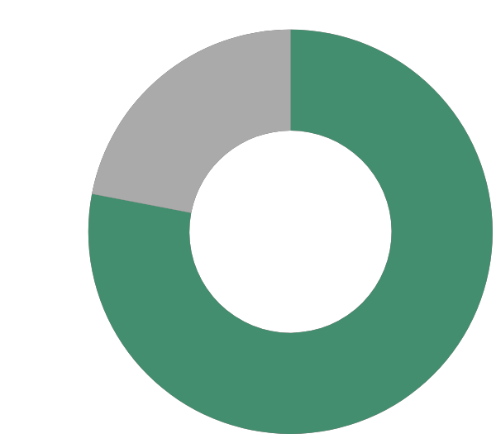
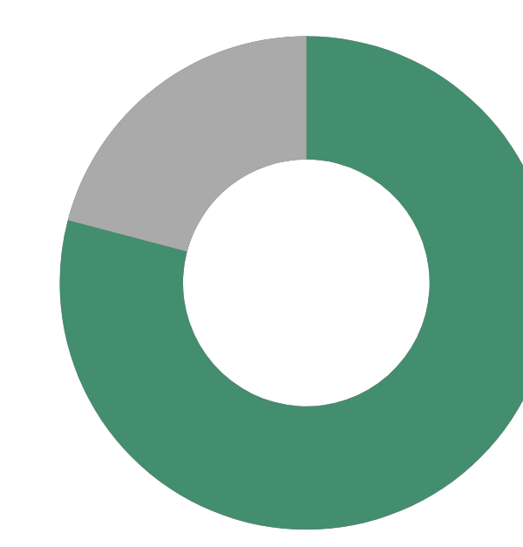
Since 2000, we have trained more than 3,200 school leaders who now reach nearly 500,000 students.
Vallejo
Chicago
Norwalk
Bay Area
New York City
Central Valley
Jersey City
Newark
Pasadena
Philadelphia
Denver
Baltimore
Arlington
Washington, DC
Dougherty
County
Dallas
Vance & Edgecombe
Counties
San Antonio
Richmond
County
Shelby County
Hidalgo County
Guilford County
Kilgore
Duval County
Clay County
WE WORK IN OVER 20 HIGH-NEED COMMUNITIES & 164 CHARTER SCHOOLS
78%
of students served are low-income
87%
of students served are children of color
Notes:
NL is based in NYC, but has a national presence. In Oakland, we worked closely with New Leaders in many areas as a partner to develop talent and leadership from teachers through to our Instructional Superintendents.

Slide 13
Components
Communities of Practice: In-person sessions designed to:
Help each individual and the group make meaning of knowledge, skills, and practices;
Build collective capacity within the group and across the school and system; and
Create a safe space where failure is an opportunity to grow and gain greater proficiency.
Leadership Walks: To build a common definition of effective leadership, collect evidence of practice, and calibrate assessments of school performance, we structure common leadership walks.
Coaching: Face-to-face or virtual
Notes:
Highlight a few of the partnerships we have underway…Denver….

Slide 14
SPOTLIGHT on PARTNERSHIP: Texas Education Agency (TEA)
Working with a hub of small, rural districts from across the state of Texas.
Designed a custom engagement with a scope and sequence aligned across roles.
Community of Practice:
AM session: Principal Supervisors, Principals and Coaches together
PM session: Role-alike smaller groups go deep with content from morning
Close out: Participants return to the whole group setting to reflect on how they can collectively apply the day’s learning across their districts
Leadership Walks with Principal Supervisors and Principals embed learning in schools
Coaching by role-alike coaches provides participants with individual support

Slide 15
TEA Feedback
Positive Feedback – Appreciation for:
Spending time as equals to improve our schools
The TLF and understanding our school action steps
Identifying district priorities and the reflective conversations that supported arriving at them
Next Steps:
Continued partnership with TEA
Expansion over state for all schools identified as “turnaround” using the TLF as the anchor tool for transformation

Slide 16
The job of school leaders is more demanding than ever, but half of principals lack access to quality training.
75% of principals say the job is becoming more complex
50% of principals report that they lack access to quality training
PRINCIPAL INSTITUTE & PRINCIPAL SUPERVISORS EMBED NEW LEADERS’ TRAINING IN LOCAL PROFESSIONAL DEVELOPMENT
Each program reshapes professional development for school leaders using New Leaders’ proven content.
New Leaders works closely with partners to analyze local needs and design a coherent course of study to address them.
System- and school-level leaders get targeted support as they master practices needed to tackle real challenges in their schools.
Source: Farkas, S., et al. (2003) Rolling up Their Sleeves: Superintendents and Principals Talk about What’s Needed to Fix Public Schools. New York: Public Agenda
Principals and Aspiring Principals Institute
Notes:
Why focus on leadership? Principals have the second largest impact on student achievement, second only to teachers, yet….the job is becoming more complex, they don’t have the training they need to be most effective. We partner with districts to offer custom content, focused on national research and local content.

Slide 17
The 16,000 high-poverty schools in the United States are more likely to be led by inexperienced, temporary principals.
THE LEADERSHIP GAP
There is not enough great talent leading our schools and our classrooms
26%
The annual principal turnover rate in low-income schools
OVER 60%
Of superintendents in high-need communities have trouble finding qualified principal candidates
Notes:
26% stat - Source is NCES - Condition of Education, Table A-34-1: http://nces.ed.gov/programs/coe/tables/table-pat-1.asp
70% stat – Source is National Charter School Research Project, “You’re Leaving? Succession and Sustainability in Charter Schools,” 2010
60% stat – Source is Public Agenda, “Trying to Stay Ahead of the Game: Superintendents and Principals Talk about School Leadership,” 2001

Slide 18
On Being A Principal
Teacher satisfaction was 62% in 2008; in 2013 it was 38%.
75 percent of principals feel that their job has become too complex.
Half of all principals feel under great stress several days a week.
About four in 10 principals say they have a great deal of control over curriculum and instruction (42%), and making decisions about removing teachers (43%).
Principal satisfaction was 68% in 2008; in 2013 it was 59%.
Michael Fullan (2014), The Principal
What are the implications for your role?
Notes:
Pose the question as a table talk or whole group or turn and talk.

Slide 19
When we focus on teachers,
our students succeed.

Slide 20
When we focus on leaders, our teachers succeed.

Slide 21
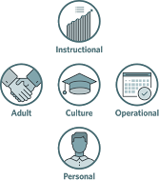
Our Research

Slide 22
PART II: The Transformational Leadership Framework

Slide 23
New Leaders Research on IMPACTING STUDENT ACHIEVEMENT
“…this book walks you through how to identify your school’s needs, how to determine the most efficient and essential actions you and your staff can take to improve student learning at your school, and how you can best put those practices in place.”
-Breakthrough Principals (page 5)
The Transformational Leadership Framework
(TLF ) highlights principal actions, yet has implications for the role of Superintendents and anyone who supports the work of Principals.
TM
TM
Notes:
Transformational Leadership Framework
Description: The TLF is the foundation for the New Leaders book: Breakthrough Principals. The TLF was adapted from the Urban Excellence Framework. Each resource was created to outline what schools achieving dramatic gains are doing in practice. The TLF is based on practices employed by some the nation's most successful principals. It informs all New Leaders program content and assessments. Since it’s publish date in 2016, the we’ve been working on aligning our content and assessments to the TLF.

Slide 24
New Leaders Research on IMPACTING STUDENT ACHIEVEMENT
Category 1: Learning and Teaching
Lever I: Aligned Curriculum
Lever 2: Classroom Practices and Instruction
Lever 3: Data
Lever 4: Student-Centered Differentiation
Category 2: School Culture
Lever 1: Shared Mission and Values
Lever 2: Relationships
Lever 3: Family and Community Engagement
Category 3: Talent Management
Lever 1: Recruitment and Onboarding
Lever 2: Instructional Leadership Team
Lever 3: Performance Monitoring and Evaluation
Lever 4: Professional Learning and Collaboration
Category 4: Planning and Operations
Lever 1: Goal Setting and Action Planning
Lever 2: Time Management
Lever 3: Budget
Lever 4: Community and District Relations
Category 5: Personal Leadership
Notes:
Refer to the Handout of the TLF here for participants. TLF is organized into Categories and Levers and stages….stages 1-3.

Slide 25
Introduction to the Transformational Leadership Framework
Notes:
As you watch the video, think about one of the areas of the TLF you are most interested in and the reasons for that interest.

Slide 26
Taking a Closer Look at the TLF
Category 1: Learning and Teaching
Lever I: Aligned Curriculum
Lever 2: Classroom Practices and Instruction
Lever 3: Data
Lever 4: Student-Centered Differentiation
Notes:
Participants Choose One lever within the TLF to look at more closely.

Slide 27
At Your Tables
Examine your assigned lever.
Guiding Questions:
What stage is your district currently in (1-3)?
What might next steps be to progress in this lever?
The TLF lists principal and school actions. What are the implications for your role?
Be prepared to share your reflections with your table.
Number Off 1-4:
1s: Lever I: Aligned Curriculum
2s: Lever 2: Classroom Practices and Instruction
3s: Lever 3: Data
4s: Lever 4: Student-Centered Differentiation

Slide 28
5-Minute Sharing for Each Lever, 4 Rounds of Sharing
Each Lever, Share
Aligned Curriculum (5 minutes)
Classroom Practices and Instruction (5 minutes)
Data (5 minutes)
Student-Centered Interventions (5 minutes)
Guiding Questions:
What stage is your district currently in (1-3)?
What might next steps be to progress in this lever?
The TLF lists principal and school actions. What are the implications for your role?
Notes:
All 1s share at tables, reflections on their lever and guiding questions….then 2s…then 3s, 4s….

Slide 29
5-Minute Sharing for Each Lever, 4 Rounds of Sharing
20 minutes

Slide 30
PART III : Overview of New Leaders Programs

Slide 31
New Leaders supports the development of leaders at every level of the system.
LEADING INSTRUCTION
TRANSFORMING TEAMS
EMERGING LEADERS
PRINCIPAL INSTITUTE
PRINCIPAL SUPERVISORS
ASPIRING PRINCIPALS
LEADING INSTRUCTION: Equips current and aspiring leaders with instructional leadership expertise aligned to high academic standards
EMERGING LEADERS: Teacher leaders and assistant principals master key leadership skills while supervising a teacher team
ASPIRING PRINCIPALS: Prepares tomorrow’s principals to achieve breakthrough results with a yearlong residency and induction support
TRANSFORMING TEAMS: Provides a structured framework for collaboration as instructional teams work together to advance student achievement
PRINCIPAL INSTITUTE: Bolsters leadership skills of current principals and assistant principals using our proven curriculum and training model
PRINCIPAL SUPERVISORS: Prepares principal supervisors to cultivate instructional excellence across a school system
Notes:
Handouts of Leadership Programs and other Resources: Also mention flexible programs and a few of the initiatives we are doing this PY. Denver focus on ILTs, TEA, focus on coherence across regions using the TLF and focus on systems, like DDI.
Time 1 minutes
Talking Points:
This slide represents New Leaders portfolio of programs we use to support the leadership development needs of our partners. Over the past 17 years we have grown to be a comprehensive leadership development solution to our partners.
We believe that leadership shows up in many ways and capacities, and in many different roles, and our organization’s focus is about strengthening people's knowledge and skills to build upon what they bring, to bring out the leadership moves that can be best leveraged to improve outcomes for the teachers and students you serve
TEA will focus its partnership with New Leaders on Principal Supervisors, Principals, and Emerging Leaders
You will learn more about the Emerging Leaders program later this afternoon

Slide 32
Exit Ticket: Session Survey Please complete before leaving today!!
Complete Our Session Feedback Survey
New Leaders values your feedback. How did we do? Did we meet the objectives for the day? Use the link provided to complete a brief survey to provide feedback on today’s session.
Contact:
Claudia Alfaro, National Executive Director, New Site Development
C: 774-273-1396 calfaro@newleaders.org
Devin Dillon, PhD
National Senior Executive Director, Instructional Design
C: 917-624-035, ddillon@newleaders.org
Notes:
Paper pencil survey for responses

